Slide 1

Yelp Insights
BY ABRACA DATA

Slide 2


Objective
Yelp Inc. is an online portal which provides crowd-sourced reviews for businesses and extends other services like restaurant table reservation
During the COVID-19 pandemic situation, ordering food online was the preferred source for people due to shelter in place orders issued by the Government and their safety
Yelp being the most popular review portal provided an edge to make informed decisions for the people during the Pandemic.
This can be an opportunity for business owners to expand their sales by keeping their Yelp profile competitive with increase in dependency of people on reviews and ratings
Our project focuses on analysing the current trends of correlation between income and restaurants business, impact of business attributes, customer’s reviews on business ratings and their price range
In this project we will be utilizing AWS-provided services and third-party software, Python, MySQL and Tableau to model, wrangle and analyse the data
The project findings will help investors to figure out the feasibility of a new venture and guide existing owners how to upscale their business margins

Slide 3
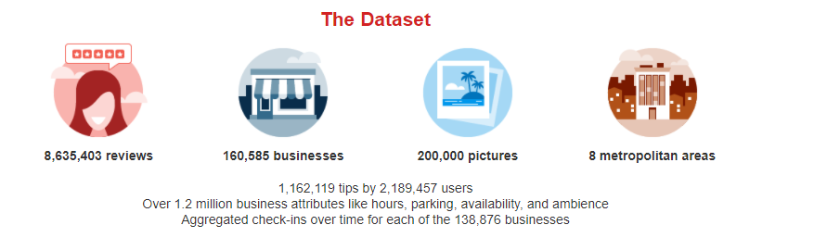


Data Source
YELP
US Household Income
Dataset
Zip Code Dataset

Slide 4
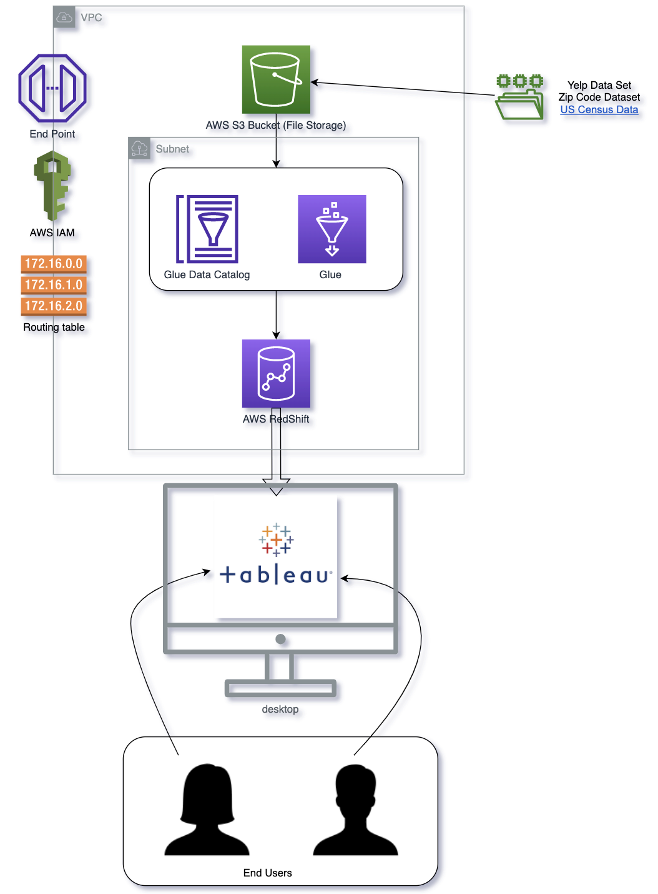
Project Architecture
AWS Services:
VPC – Virtual Private Cloud
IAM
S3
Glue
Redshift
Security Groups for 3rd Party Integration
Other Services:
External Data sets
2. Tableau Visualization

Slide 5
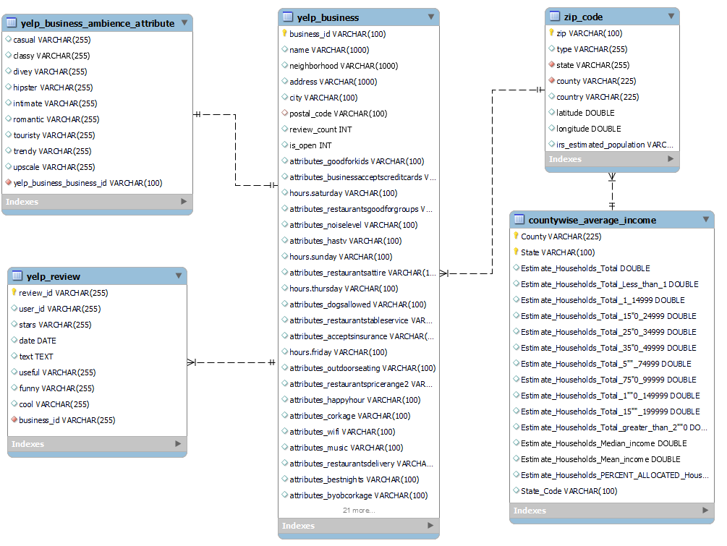
Data Model

Slide 6
Data Wrangling
Extract Transform Load ➔ AWS GLUE, Python Notebook and AWS Redshift ‘COPY’ command
Yelp Business (JSON file) was uploaded in S3 bucket. Using Glue Job nested JSON structure was flattened into tabular columns ,cleansed, filtered and required fields were loaded into AWS Redshift Cluster
Yelp Review (JSON file) was uploaded in S3 bucket. Using COPY command filters and JSON schema file data was flattened into columnar data and loaded into AWS Redshift cluster
Yelp Business Ambience Attributes (nested string format) was fetched from Yelp business file and converted into JSON format using python. After conversion processed file was uploaded in S3 and AWS Redshift Cluster
US Census Household Income (csv file) was uploaded in S3 bucket. Using Glue Job data was cleanse, filtered and required fields were loaded into AWS Redshift Cluster
Zip Code (csv file) was converted to text pipe delimited file to avoid truncation of leading zeros in ZIP Code using python and then uploaded in S3 bucket. Further copied to AWS Redshift using features of COPY command

Slide 7
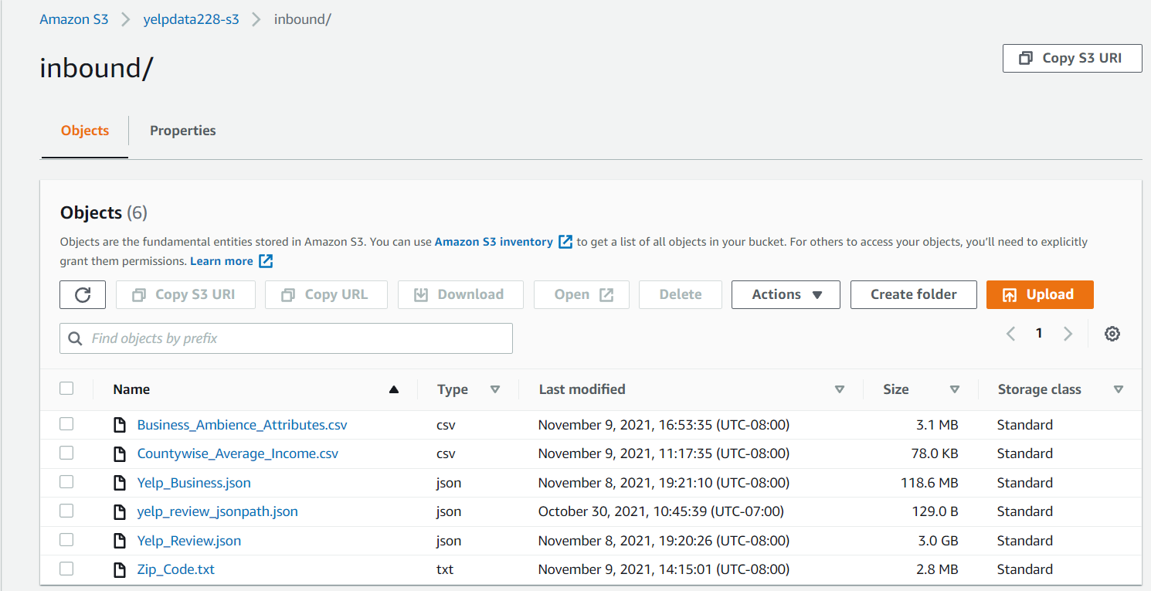
AWS S3 Storage

Slide 8
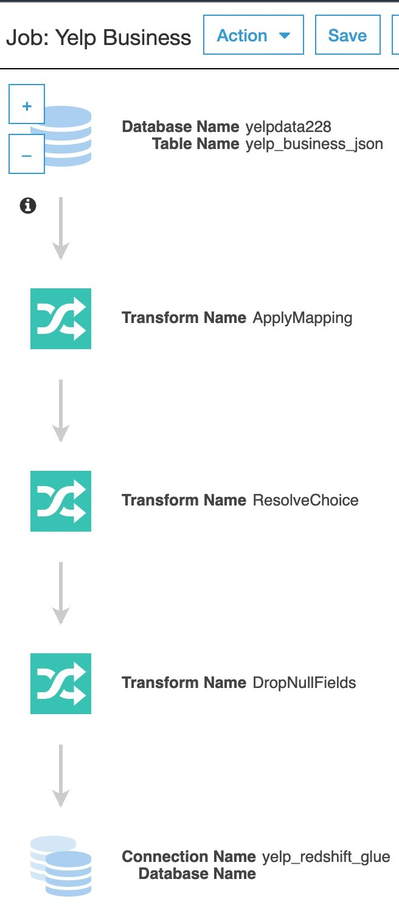
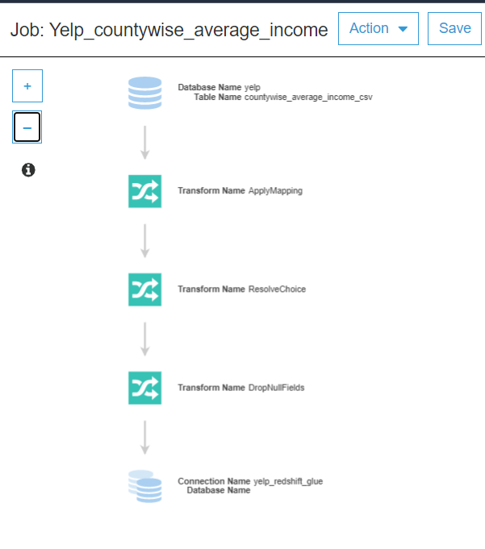
AWS Glue Jobs
Yelp Business (JSON file)
US Census Household Income (csv file)

Slide 9
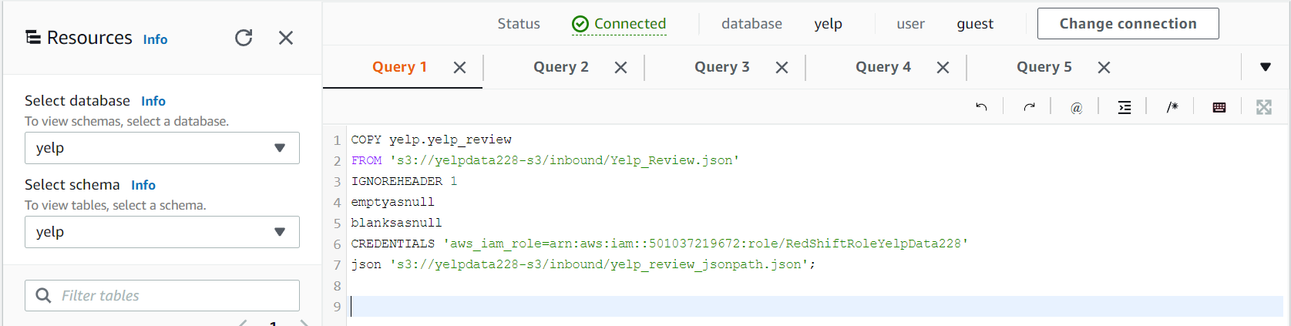
Other ETL Methods
Yelp Review (JSON format)

Slide 10
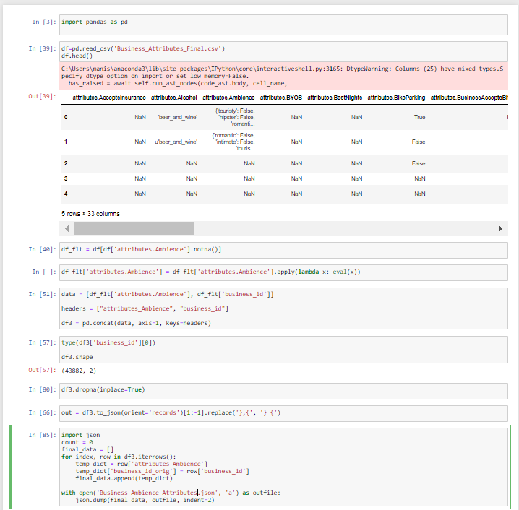
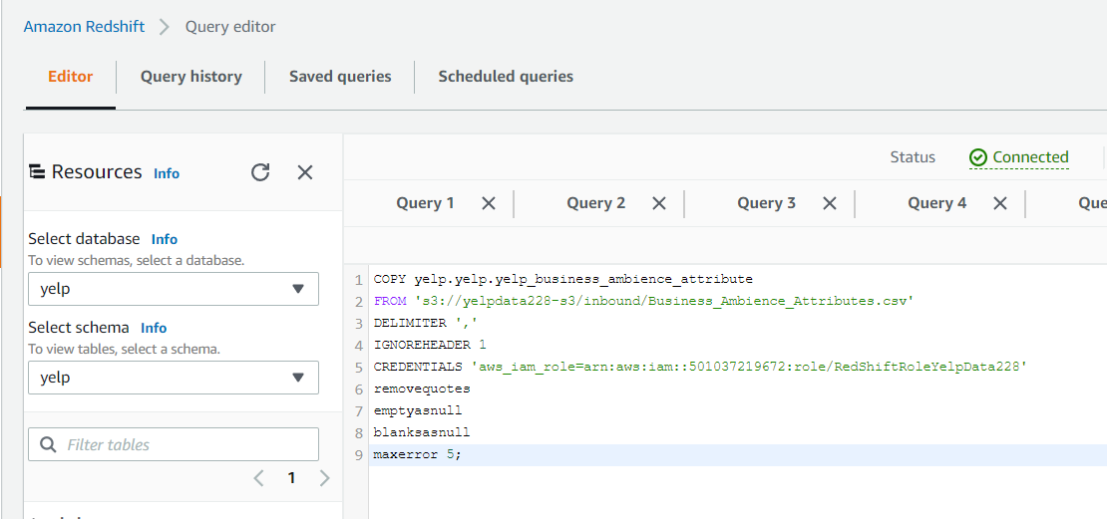
Other ETL Methods
Yelp Business Ambience Attributes (nested string format)
Python Code Snippet
AWS Commands

Slide 11
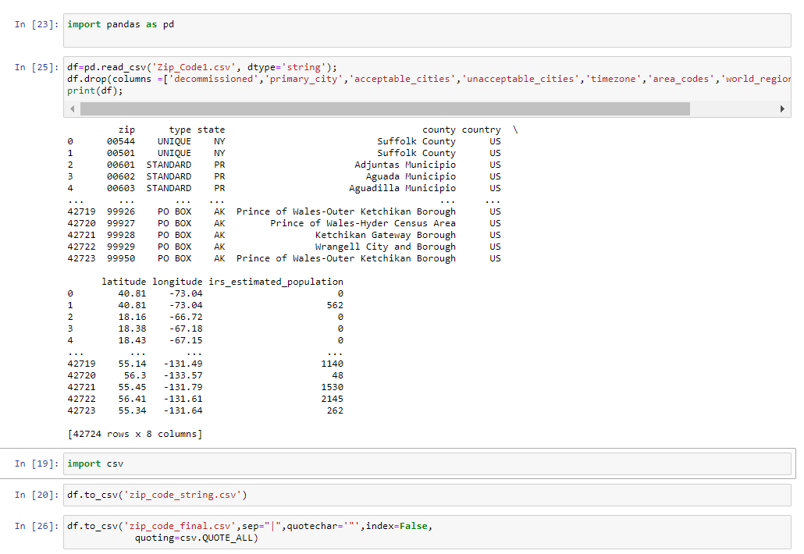
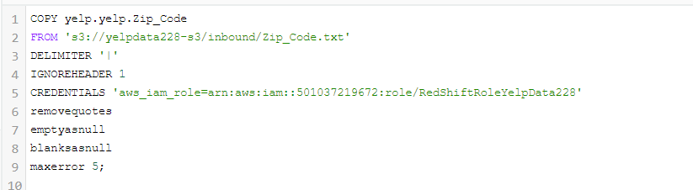
Other ETL Methods
Zip Codes Dataset (csv format)
Python Code Snippet
AWS Commands

Slide 12
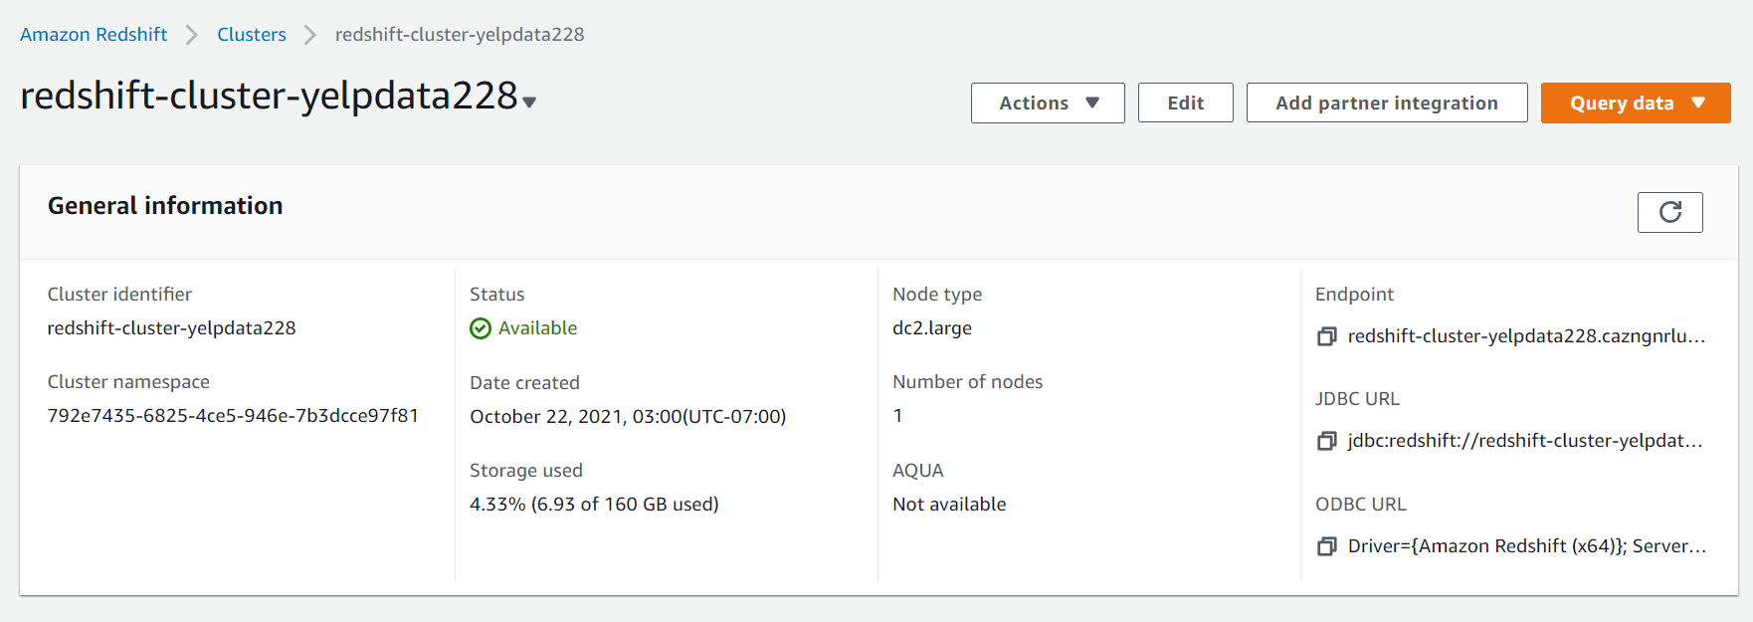
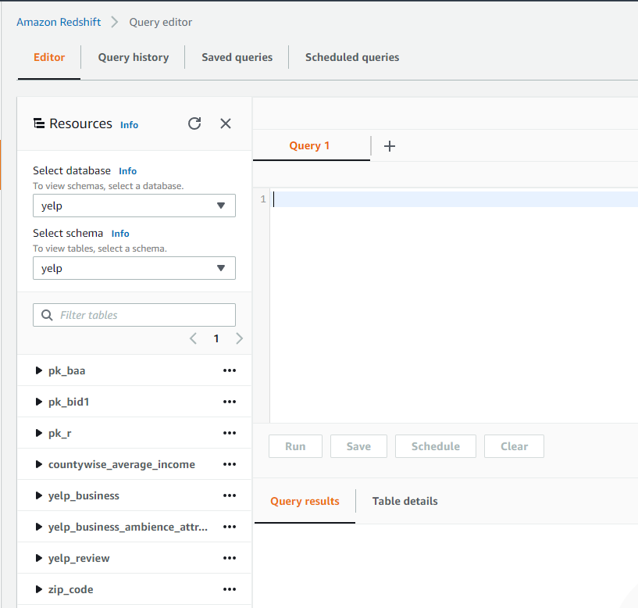
AWS Redshift Cluster

Slide 13
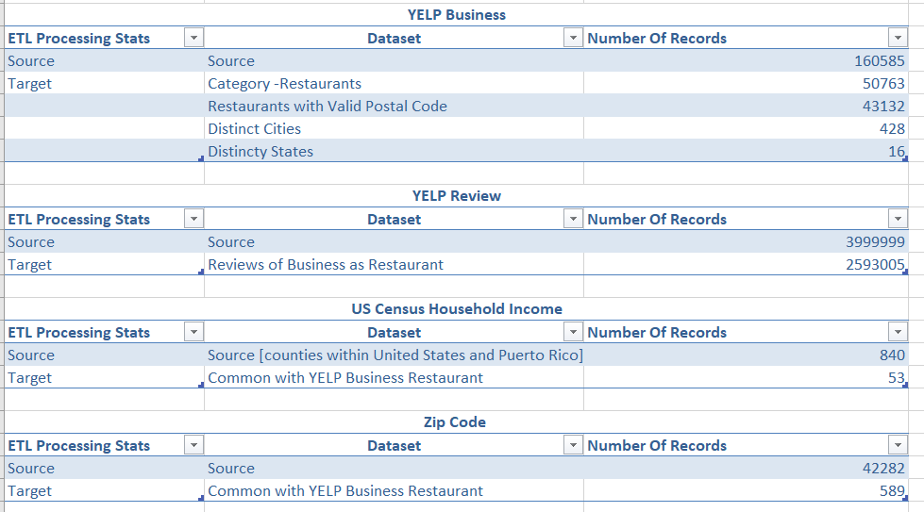
ETL Statistics

Slide 14
Visualization
Tableau Story- I
Tableau Story-II
Tableau Story -III

Slide 15
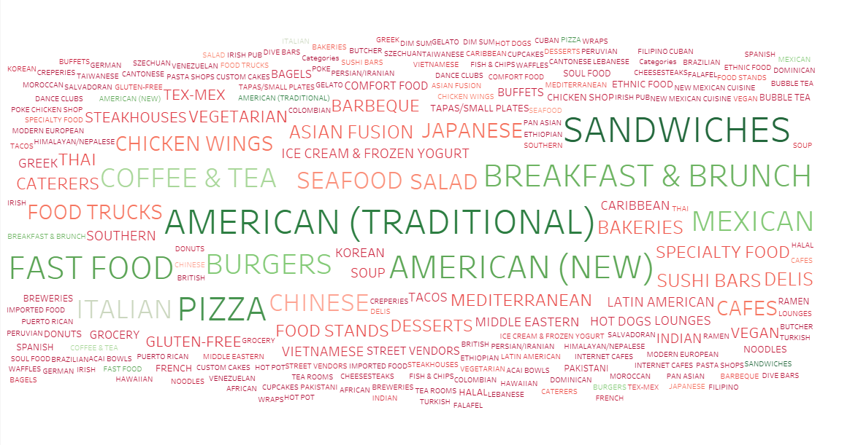
Word Cloud of Cuisines

Slide 16
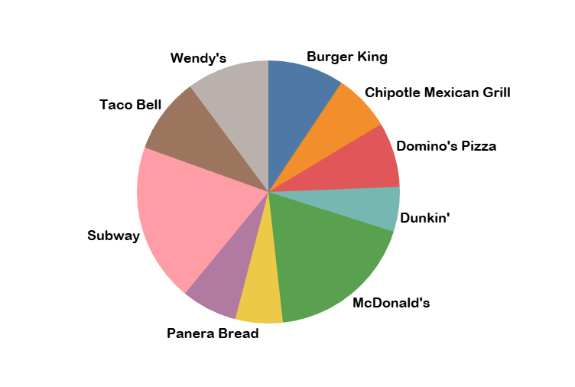
Top Ten Restaurants by Count

Slide 17
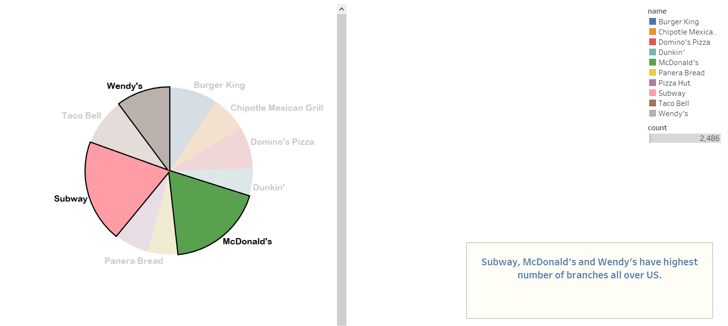
Top Ten Restaurants by Count

Slide 18
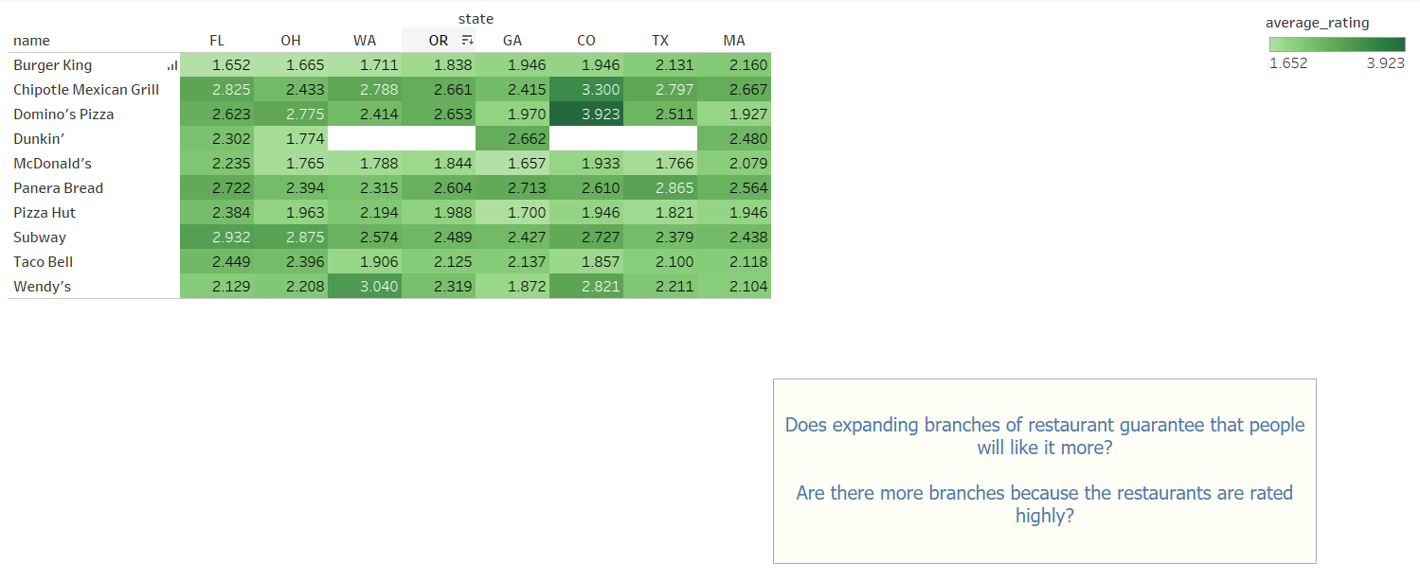
Average Rating of Top Ten Restaurants

Slide 19
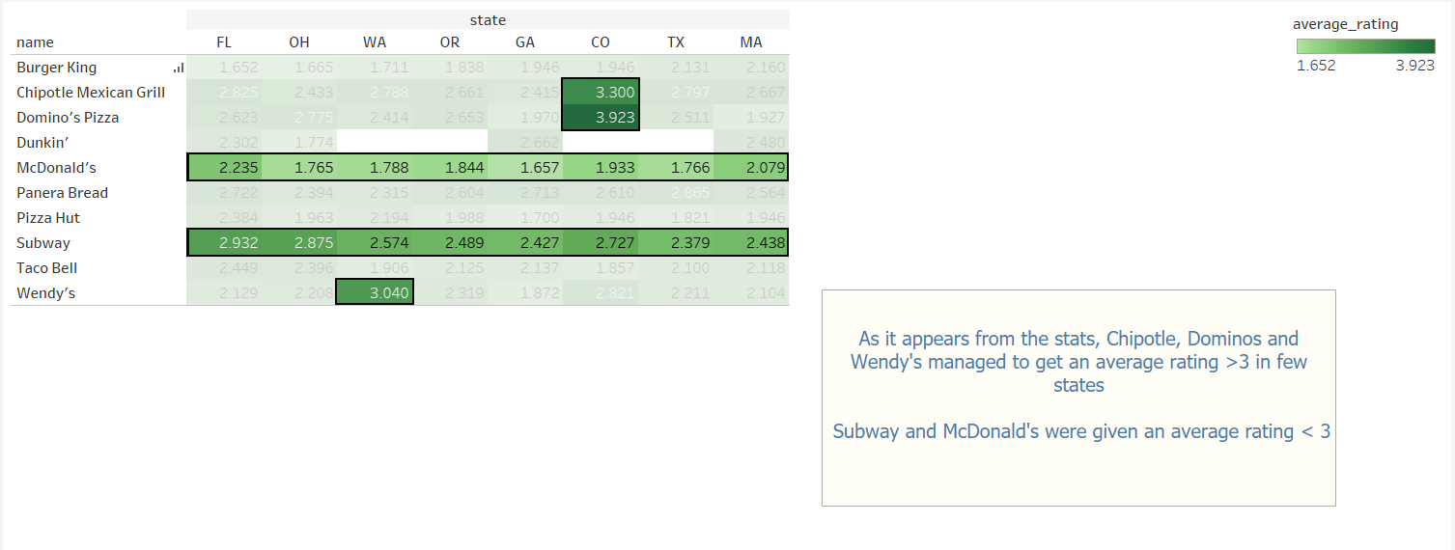
Average Rating of Top Ten Restaurants

Slide 20
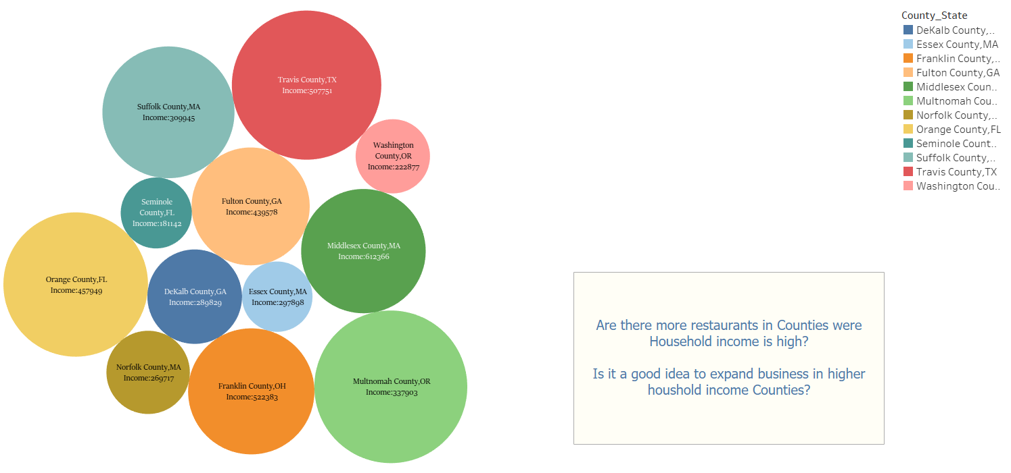
Relation between Average Household Income of County and Number of Restaurant (Top 12)

Slide 21
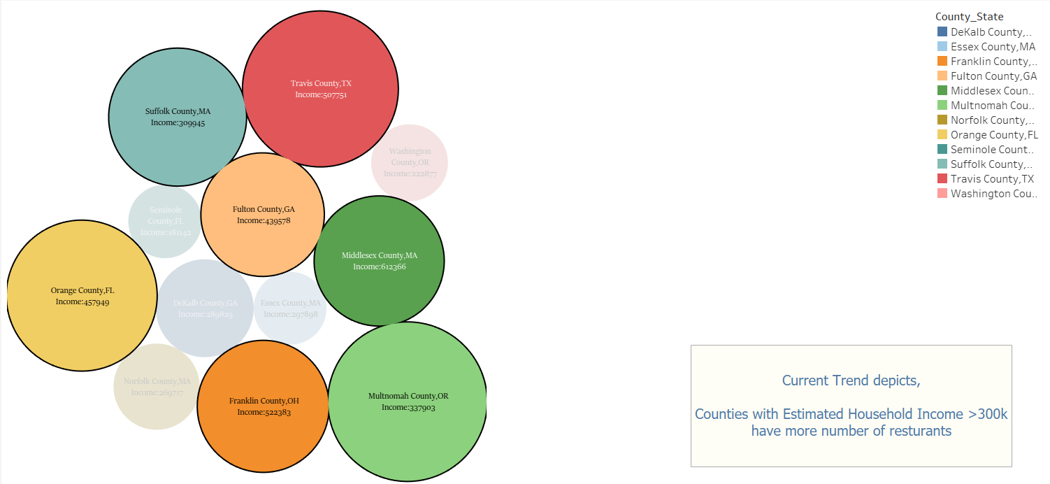
Relation between Average Household Income of County and Number of Restaurant (Top 12)

Slide 22
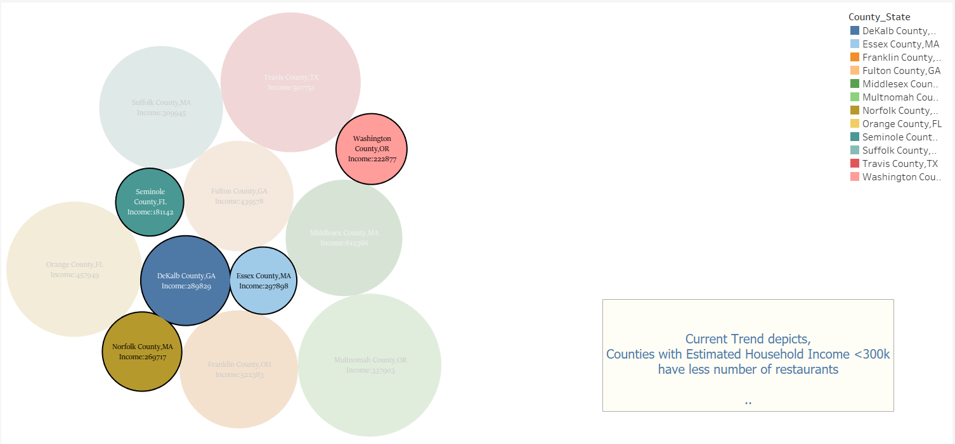
Relation between Average Household Income of County and Number of Restaurant (Top 12)

Slide 23

Relation between Average Household Income of County and Number of Restaurant (Top 12)

Slide 24
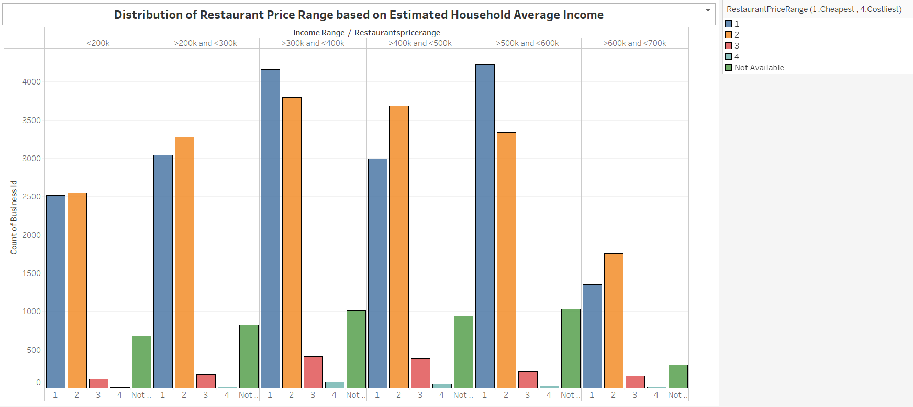

Slide 25
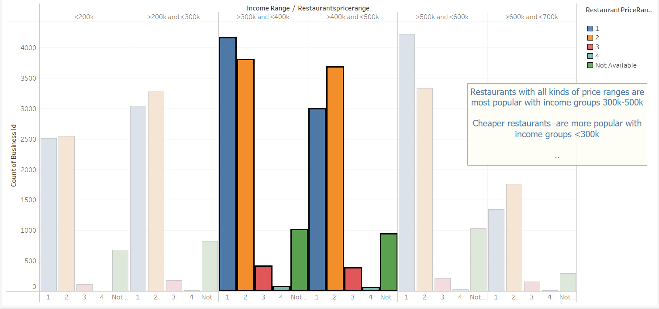
Distribution of Restaurant Price Range based on Average Household Income

Slide 26
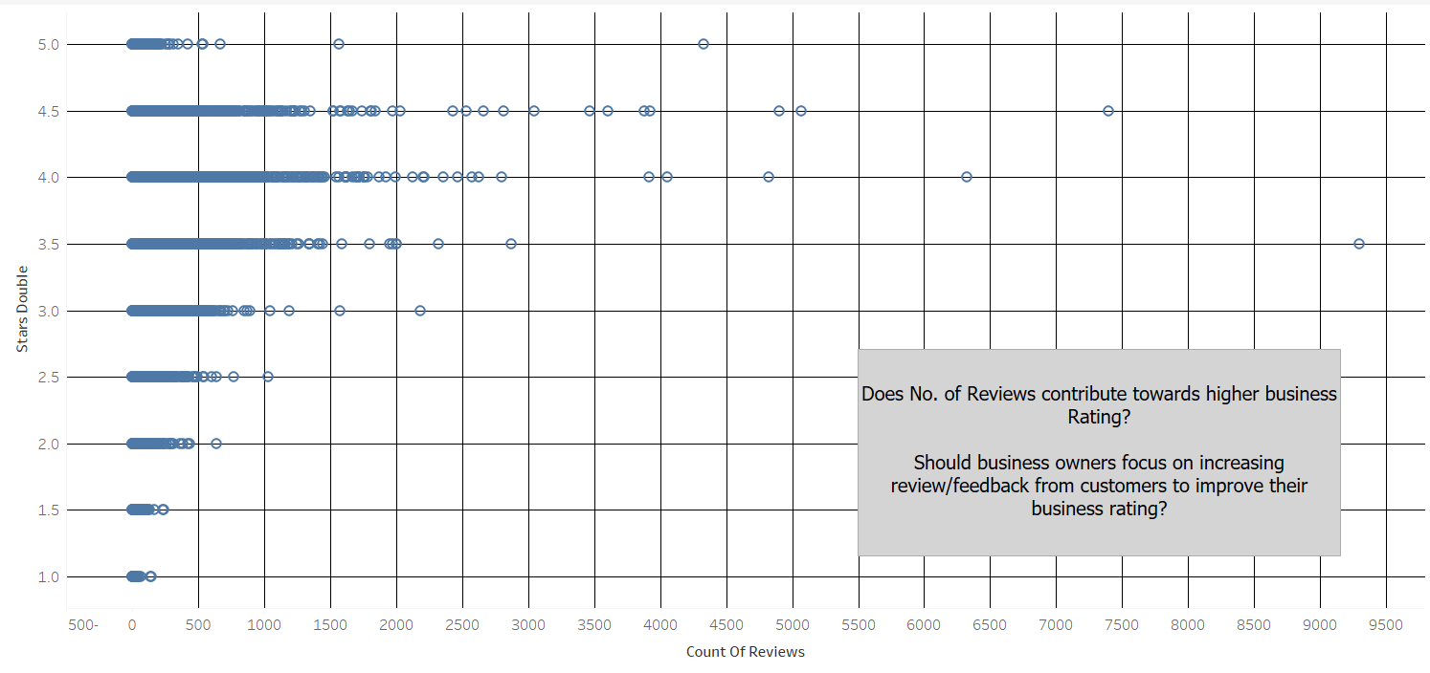
Number of Reviews Vs Restaurant Rating

Slide 27
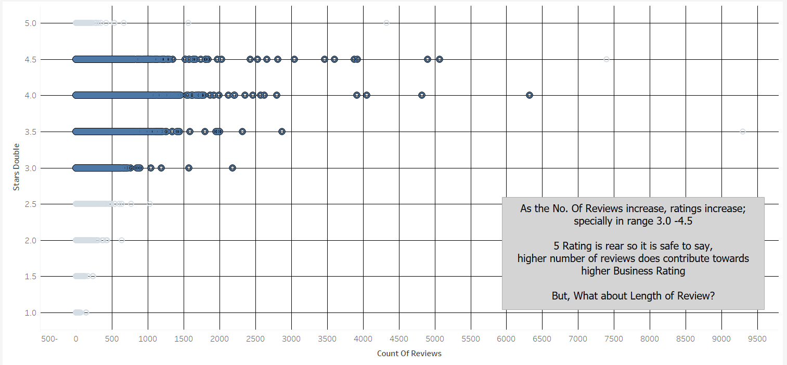
Number of Reviews Vs Restaurant Rating

Slide 28
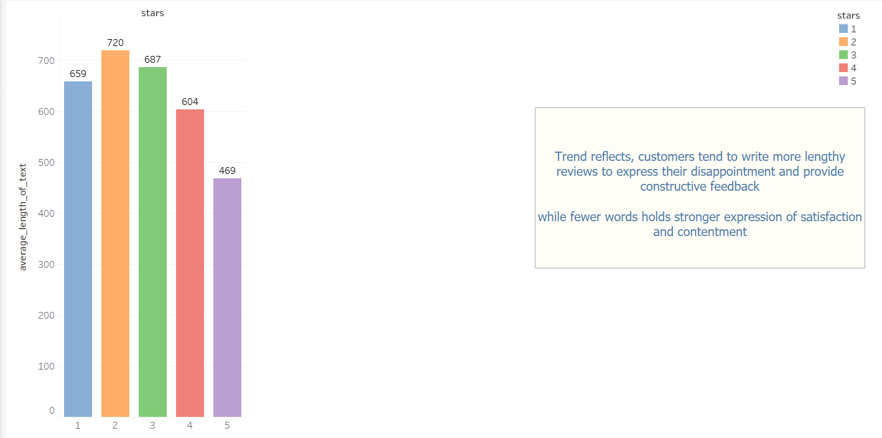
Number of Reviews Vs Restaurant Rating

Slide 29
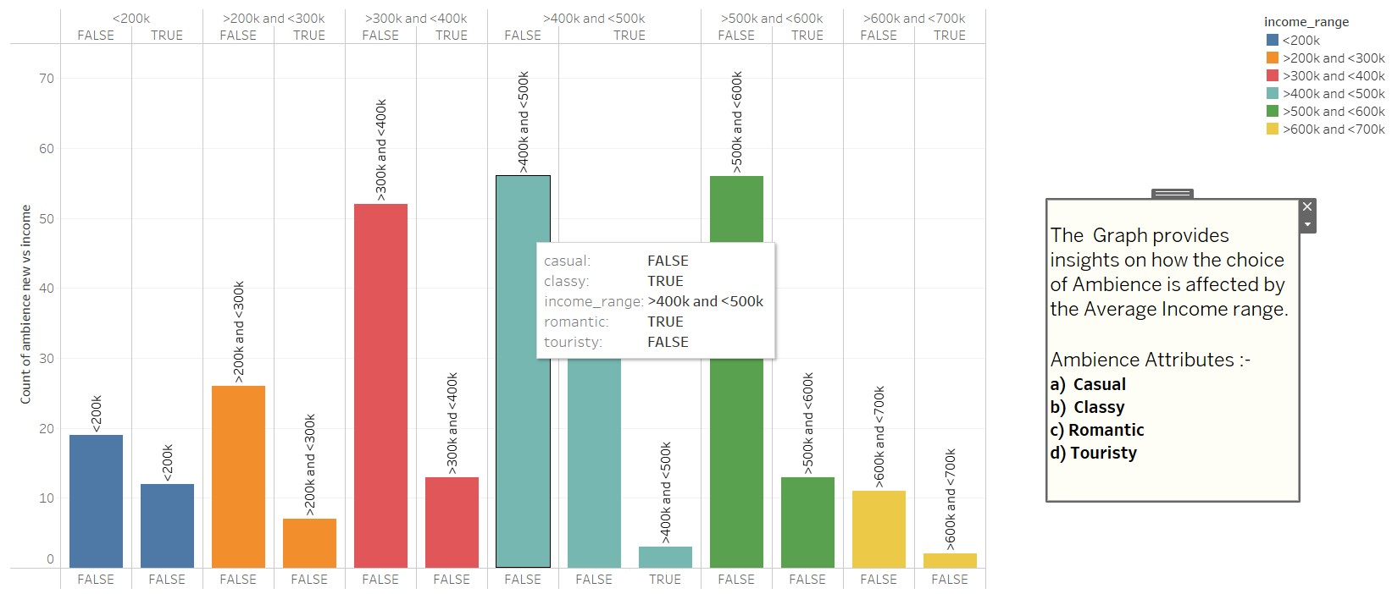
Comparison between Ambience vs Estimated Average Income Range

Slide 30
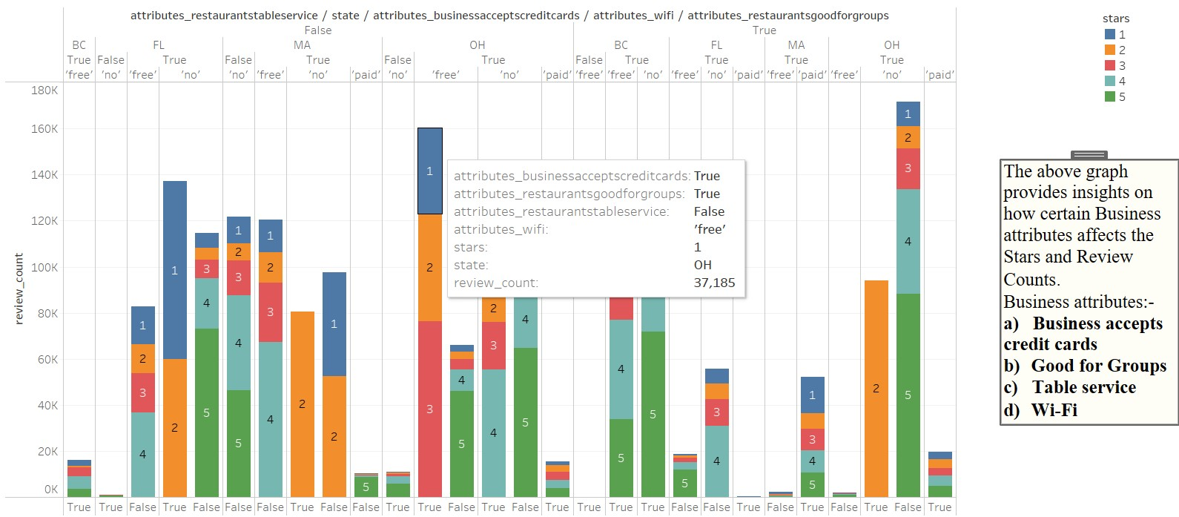
Effect of Business Attributes on Stars and Reviews

Slide 31
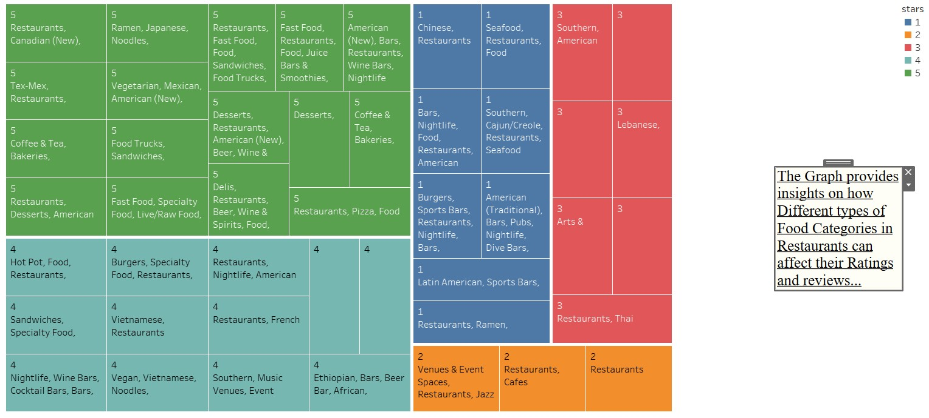
Effect of Food Categories on Ratings

Slide 32
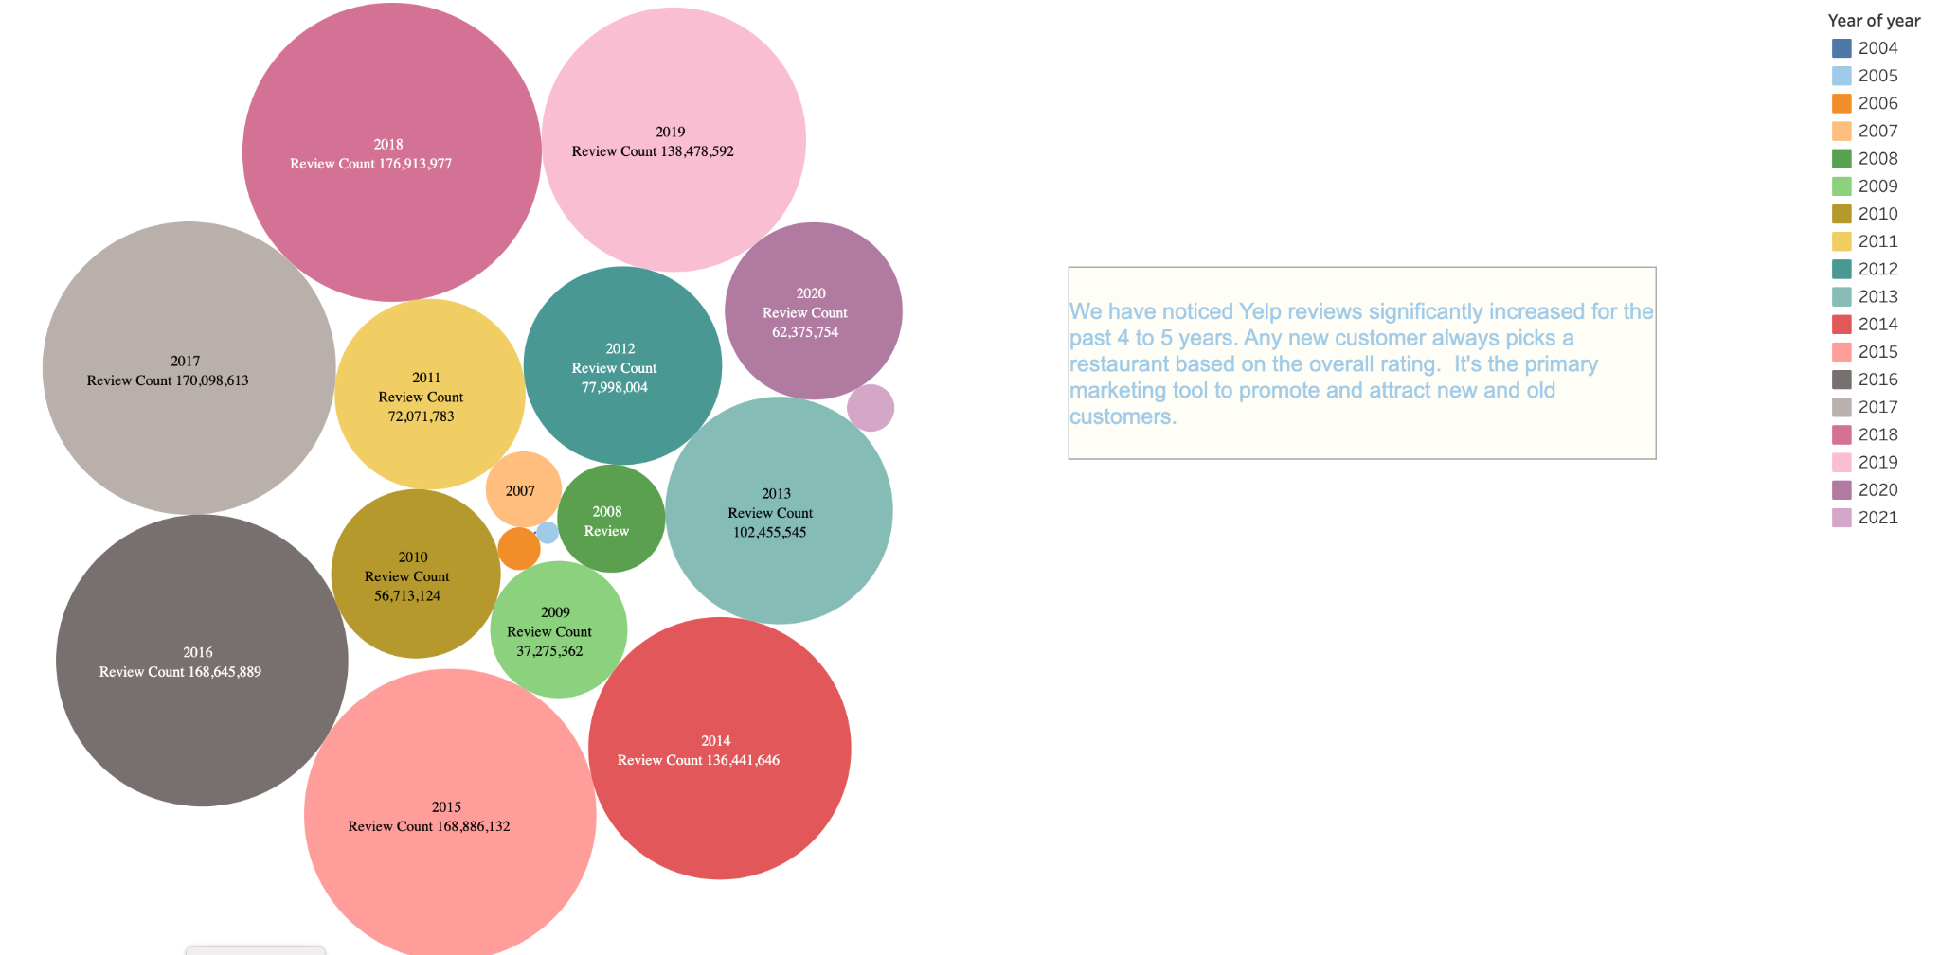
Review Count and it's progression over the years

Slide 33
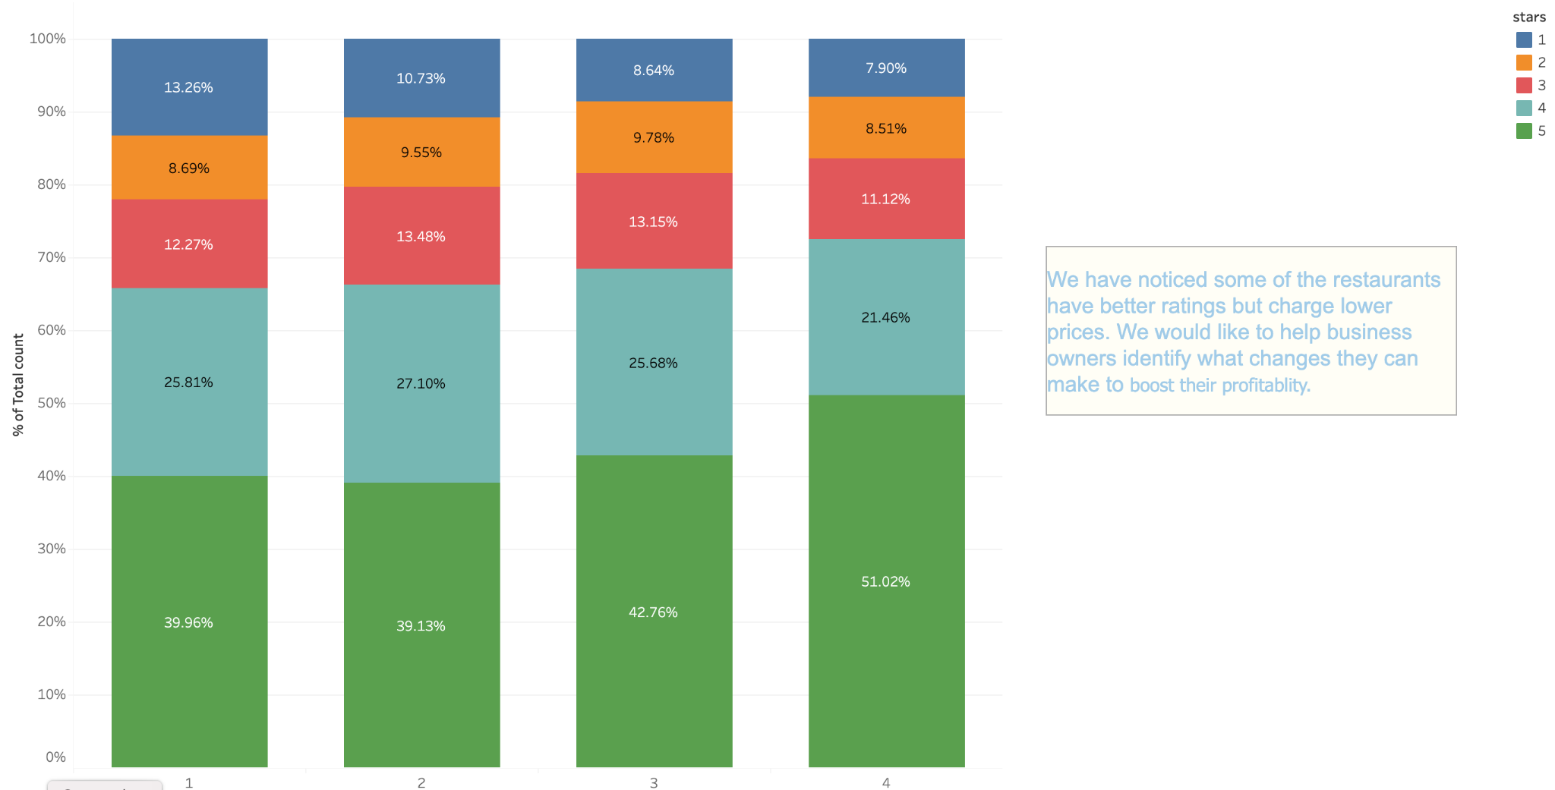
Restaurant price range($) to user rating analysis

Slide 34
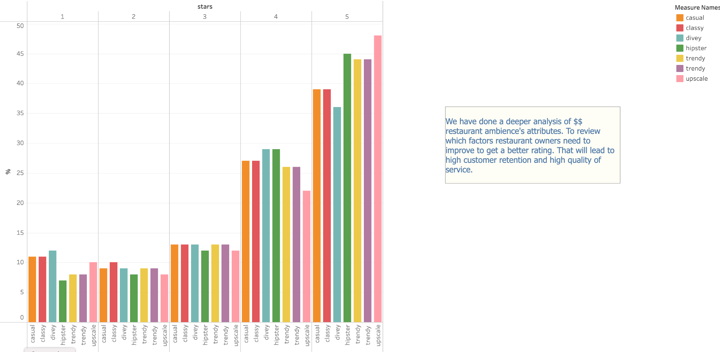
Restaurant price range($$) with ambience analysis

Slide 35
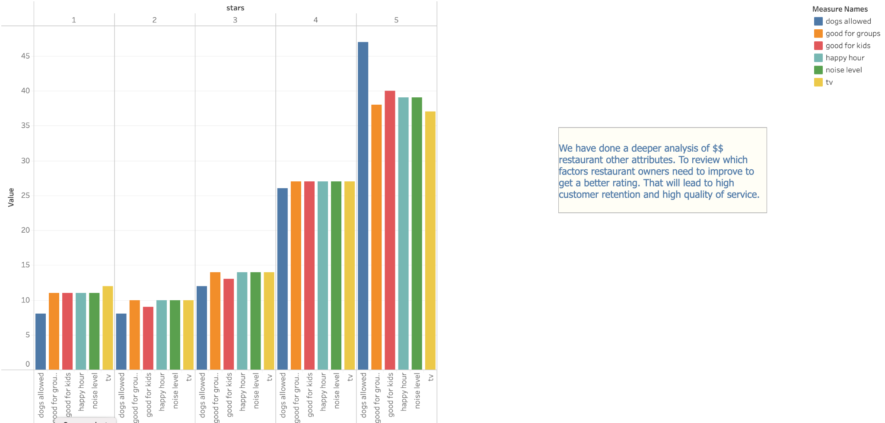
Restaurant price range($$) with other attributes analysis

Slide 36
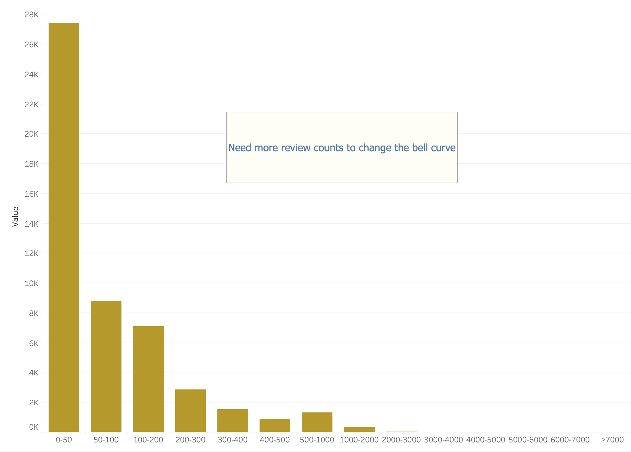
Users review count by businesses

Slide 37
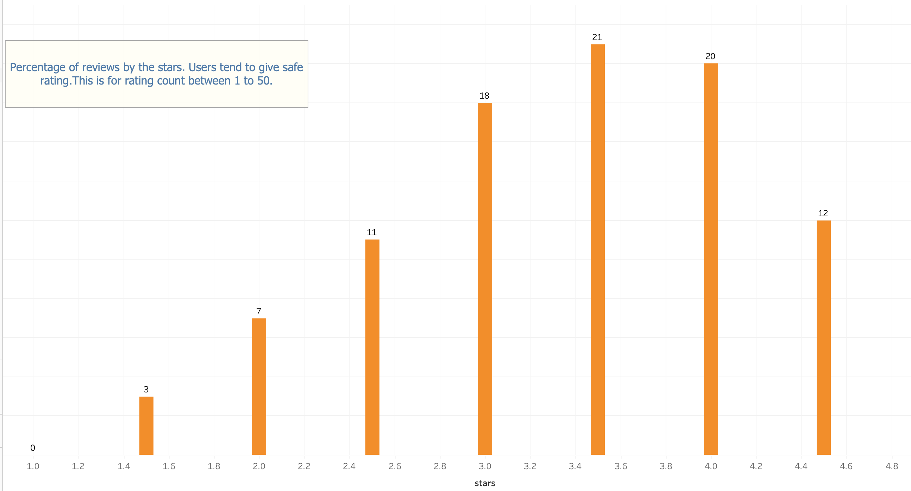
Correlation of business stars with percentage of reviews (1 - 50)

Slide 38
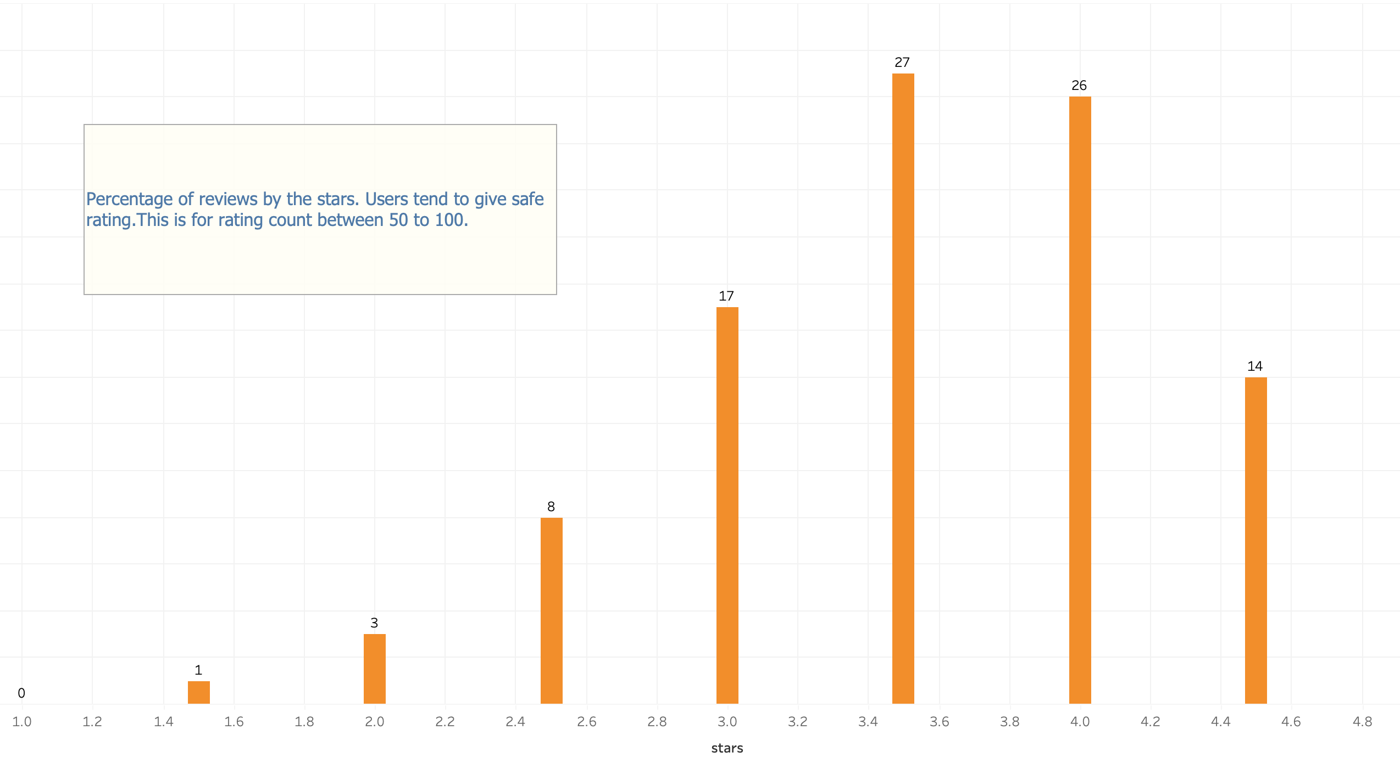
Correlation of business stars with percentage of reviews (50 - 100)

Slide 39
Website hosted on AWS
Website Link

Slide 40
Conclusion
Our project focuses on analyzing current patterns of Restaurant Business on basis of Yelp Dataset and supporting US Census Household income dataset.
We brought together the holistic view of below parameters which will enable existing business owners and new investors in Restaurant ventures to make informed decisions
Most popular cuisine
Top restaurants
Citizen's household Income and their influence on existing businesses patterns
Contribution of business attributes towards business ratings and customer experience
American, Sandwiches , Fast Food and Mexican cuisines are widely available in the US. New venturers can look out for less available food options to cover a broader market
Restaurants having a greater number of outlets are not necessarily the highest rated businesses
We see a positive relationship between the household income and restaurants count
The higher the no. of reviews a business has the more likely it is to have a better rating
People having a higher income rate does not necessarily mean that they always prefer expensive restaurants
While the number of reviews has been growing consistently over the the years, there has been a decline in past two year due to pandemic
There is not much disparity between the restaurant price range and the ratings
The bell curve is consistent between the volume of reviews versus stars(rating) on a business implying that users give a median rating

Slide 41

Future Scope
Integrate Yelp Dataset with US population for each County to find correlation with Businesses
Integrate Yelp Dataset with US area for each County to find correlation with Businesses
Create an interactive Web Application of Data Analytics
Perform ML Sentiment Analysis on Business Reviews
Perform deeper analysis of Reviewer comments
Identify areas of improvements using advanced statistical tools that businesses can incorporate for market value

Slide 42
Reference Links
Website:
https://websiteyelpinsights.s3.us-west-1.amazonaws.com/YelpInsightsWebsite/Home.html
Source:
https://data.census.gov/cedsci/table?q=Income%20%28Households,%20Families,%20Individuals%29&g=0400000US01%240500000,02%240500000,04%240500000&tid=ACSST1Y2019.S1901&hidePreview=true
https://www.yelp.com/dataset
https://www.unitedstateszipcodes.org/
GitHub:
https://github.com/vanikancherlapalli/Abraca-Data-228
Architecture Diagram:
https://app.diagrams.net/
Tableau Dashboard:
https://public.tableau.com/app/profile/manisha.paliwal/viz/YelpInsightsByAbracaData/YelpInsights?publish=yes
https://public.tableau.com/app/profile/vani.k4703/viz/YelpInsightsByAbracaData_Vani-1/YelpInsights?publish=yes
https://public.tableau.com/app/profile/chidroop.sagar1502/viz/YelpInsightsbyAbracaData/AbracaDataVisualisationCs?publish=yes
Images:
https://www.census.gov/
https://www.yelp.com/dataset
https://www.dictionary.com/e/zip-code/
https://www.clipartmax.com/middle/m2H7K9G6Z5K9i8Z5_future-scope-clipart-man-with-binoculars-png/
Website Development Reference:
Main Image
Yelp Image
US Census Image
Zip Code Image

Slide 43


